Slide 1
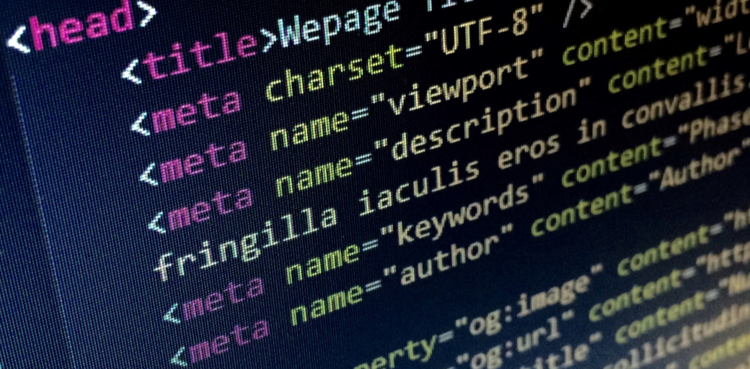
Personal Photography Portfolio Site
- By Jen Kettle P2714765
1 of 20

Slide 2
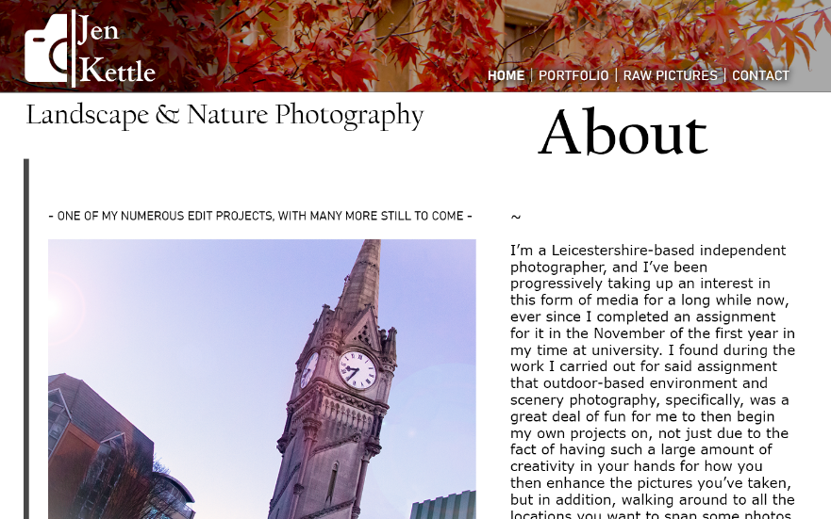
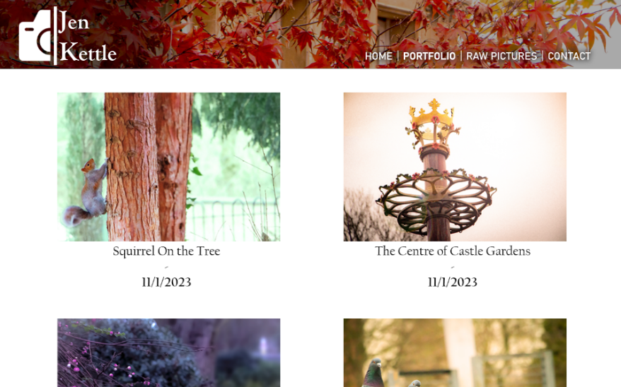
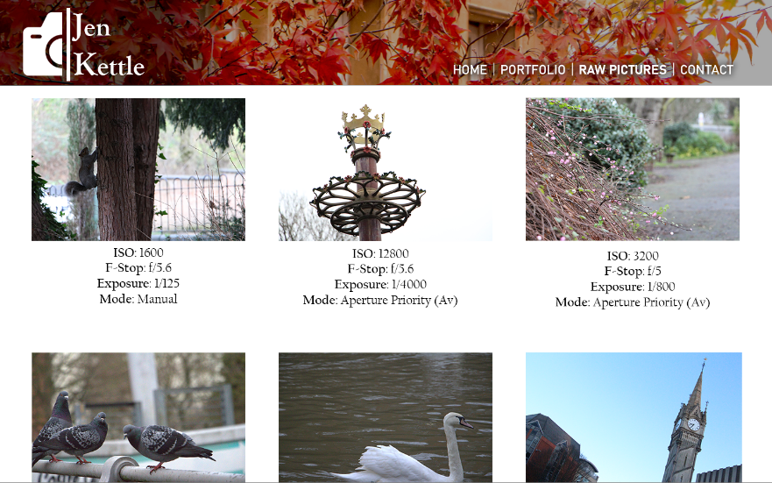
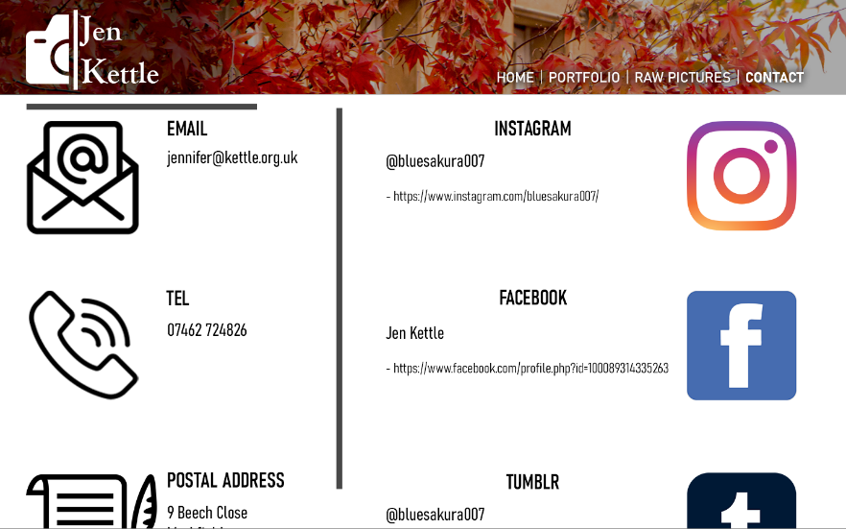
Chosen concept – similar to the web pages I designed in the previous half of the module taught by Jonny Dutra, so I’m now making that somewhat of a reality
2 of 20

Slide 3
Similarities to the Original Photoshop Design Concept
Same header bar image
Similar thin, elegant-looking font and the same colour for the name text within said header bar
Same planned Home page written sentences from the main text body
Photography works shown on the Portfolio page set to be displayed in equal rows of two each
Involves the displaying of the technical specifications of the camera when the photographs were taken
Same social media links and other means of contact listed
3 of 20

Slide 4
Differences
In this case, the name text in the header bar glows
There isn’t an area of shadow behind said name text
A video link is included on the Home page, with a golden tilde symbol on either side for decorative purposes
The image shown on Home isn’t an example of one of my photographic works but in this case is instead an avatar image of myself, with a rounded border
The contact links and details aren’t listed as the content of one specific page, and are shown in a column down the bottoms of both of the programmed pages as a footnote
The navigation bar is shown as its own quasi-section beneath the header bar and tagline rather than being another part of said header area, with no drop shadow underneath the text links to the two pages
The technical specifications and details of each photograph are displayed as features to be found when the photos are clicked on, instead of these details being on their own page
4 of 20

Slide 5
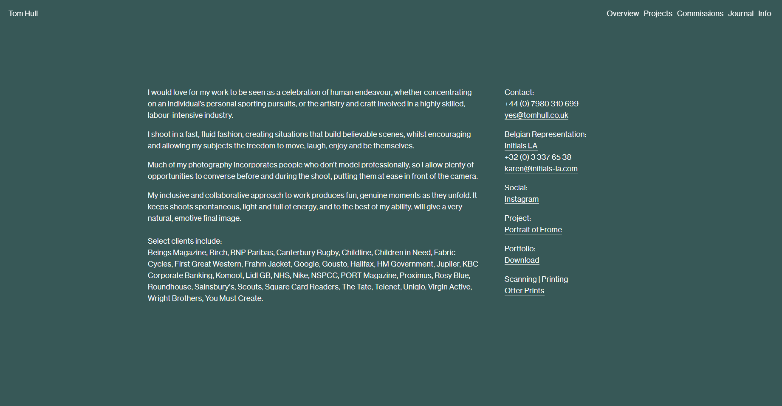
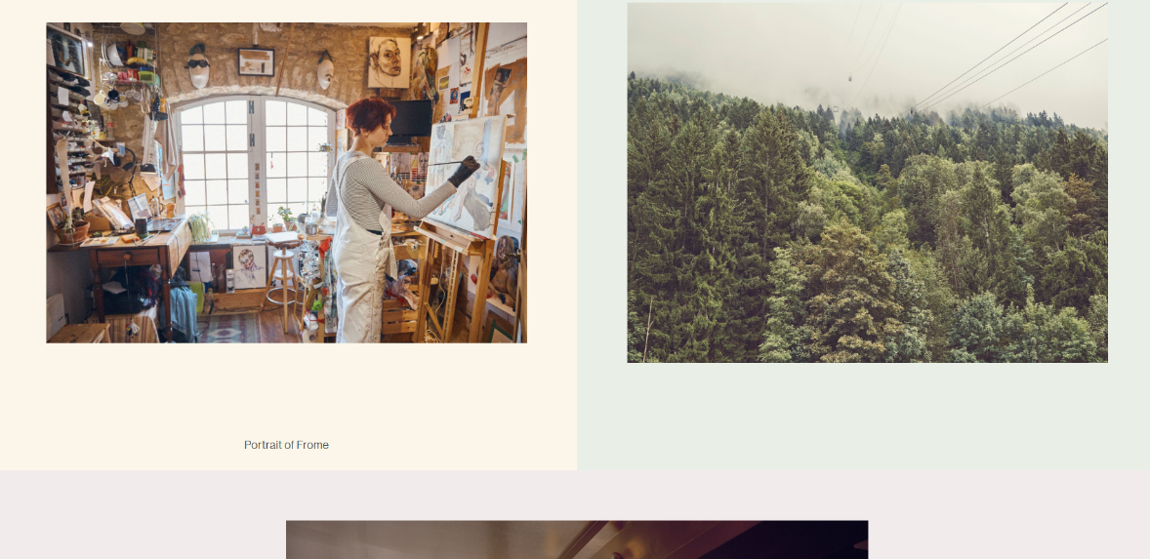
Inspiration Site 1/3: Tom Hull
This was the website which inspired my design concept for the previous half of the module in the first place, and thus my HTML/CSS-coded site in this half is a further improvement measure of sorts upon it.
The neat and sleek-looking organization of his own website’s Info (left) and Projects pages pictured above is something that I like, although while I was writing out the programming for mine when it was still being developed, the large amounts of empty space on Info around the text paragraphs were something that I hoped to avoid, and so was the bland, plain appearance of the header bar shown at the top of every page, with text elements that are too small and definitely not as eye-catching as they should’ve been.
5 of 20

Slide 6
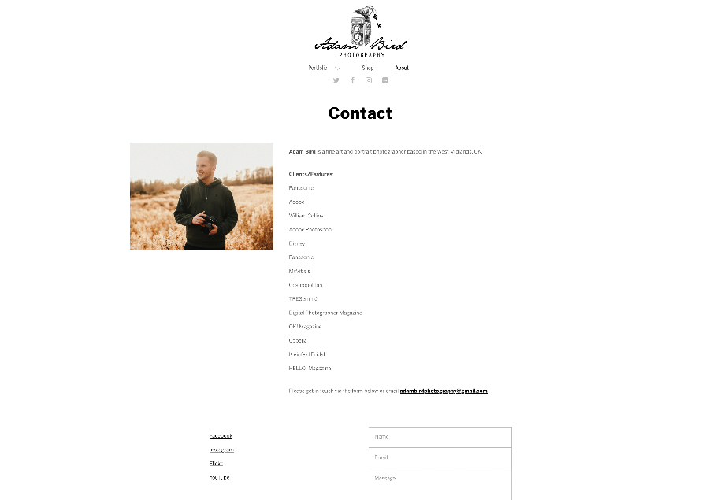
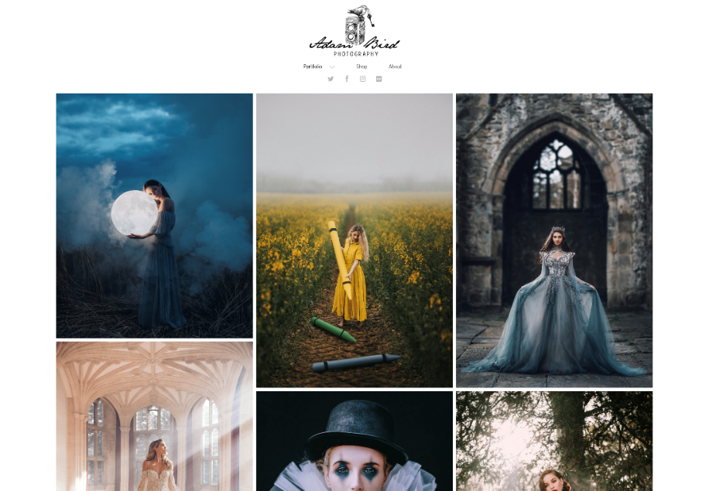
Inspiration Site 2/3: Adam Bird
This is another photographer website I found which had an appealing general appearance due to its neatness, and though I wasn’t entirely able to understand how to arrange the photographs on my Portfolio page in the same somewhat uneven manner via my HTML and/or CSS code, this was another aspect of Adam Bird’s site that I found to add to this appeal in its look.
However, although the header bar constant for all pages is more eye-catching than Tom Hull’s and the content on this site’s About page is also arranged neatly, the latter – not unlike the text shown on Tom Hull’s Info page – also seems to have a lot of empty white space around it, making this particular page look rather barren.
6 of 20

Slide 7
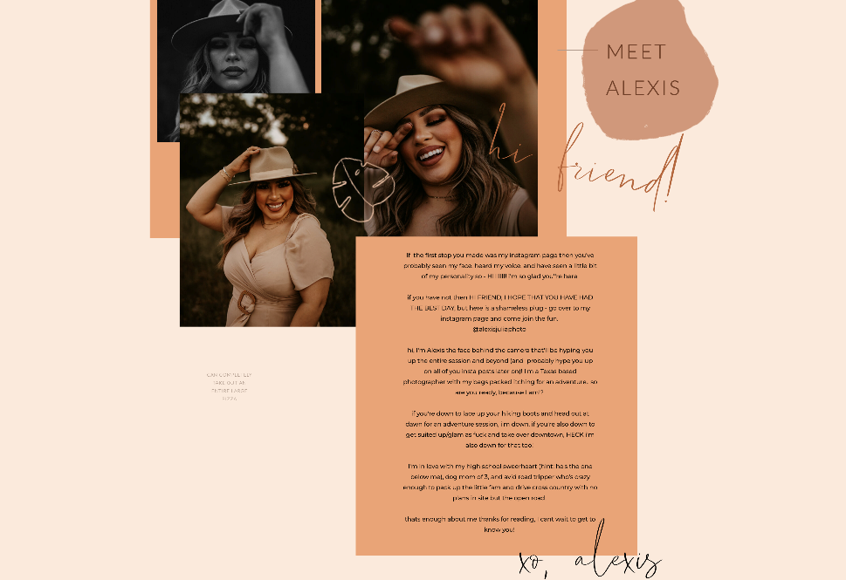
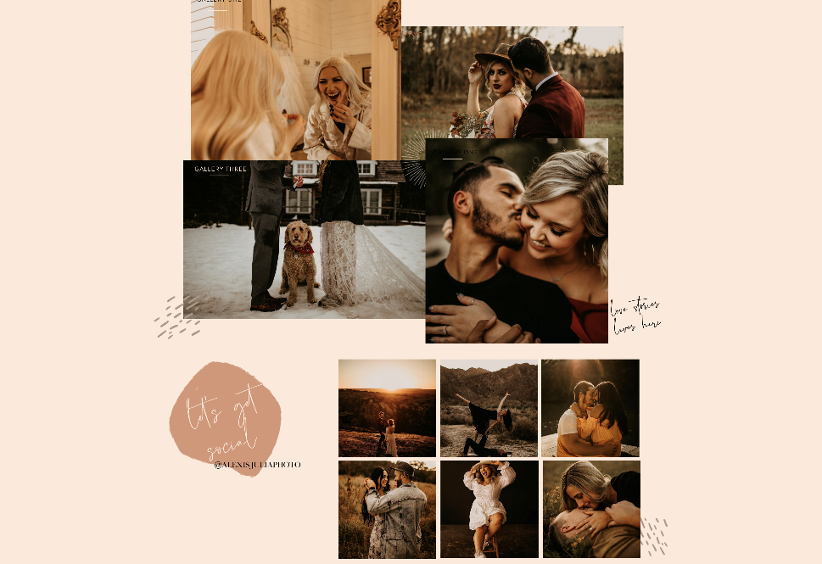
Inspiration Site 3/3: Alexis Julia
Finally, in the case of the website of Alexis Julia as another of my inspiration sources for my own site, in comparison to the previous two displayed examples the content on hers, both in image and text form, appears to have more of a disjointed look, with some elements even overlapping. This is another technique that during my site’s development I didn’t entirely know how to implement myself in the programming, but nonetheless I did think this finding was an appealing trait of Alexis Julia’s pages. Furthermore, I also quite liked how for the most part she’s avoided having empty, barren space around her shown elements, and the warm but not glaring colour tone which she’s used for the website as a whole is something I’ve decided to make use of for mine.
7 of 20

Slide 8
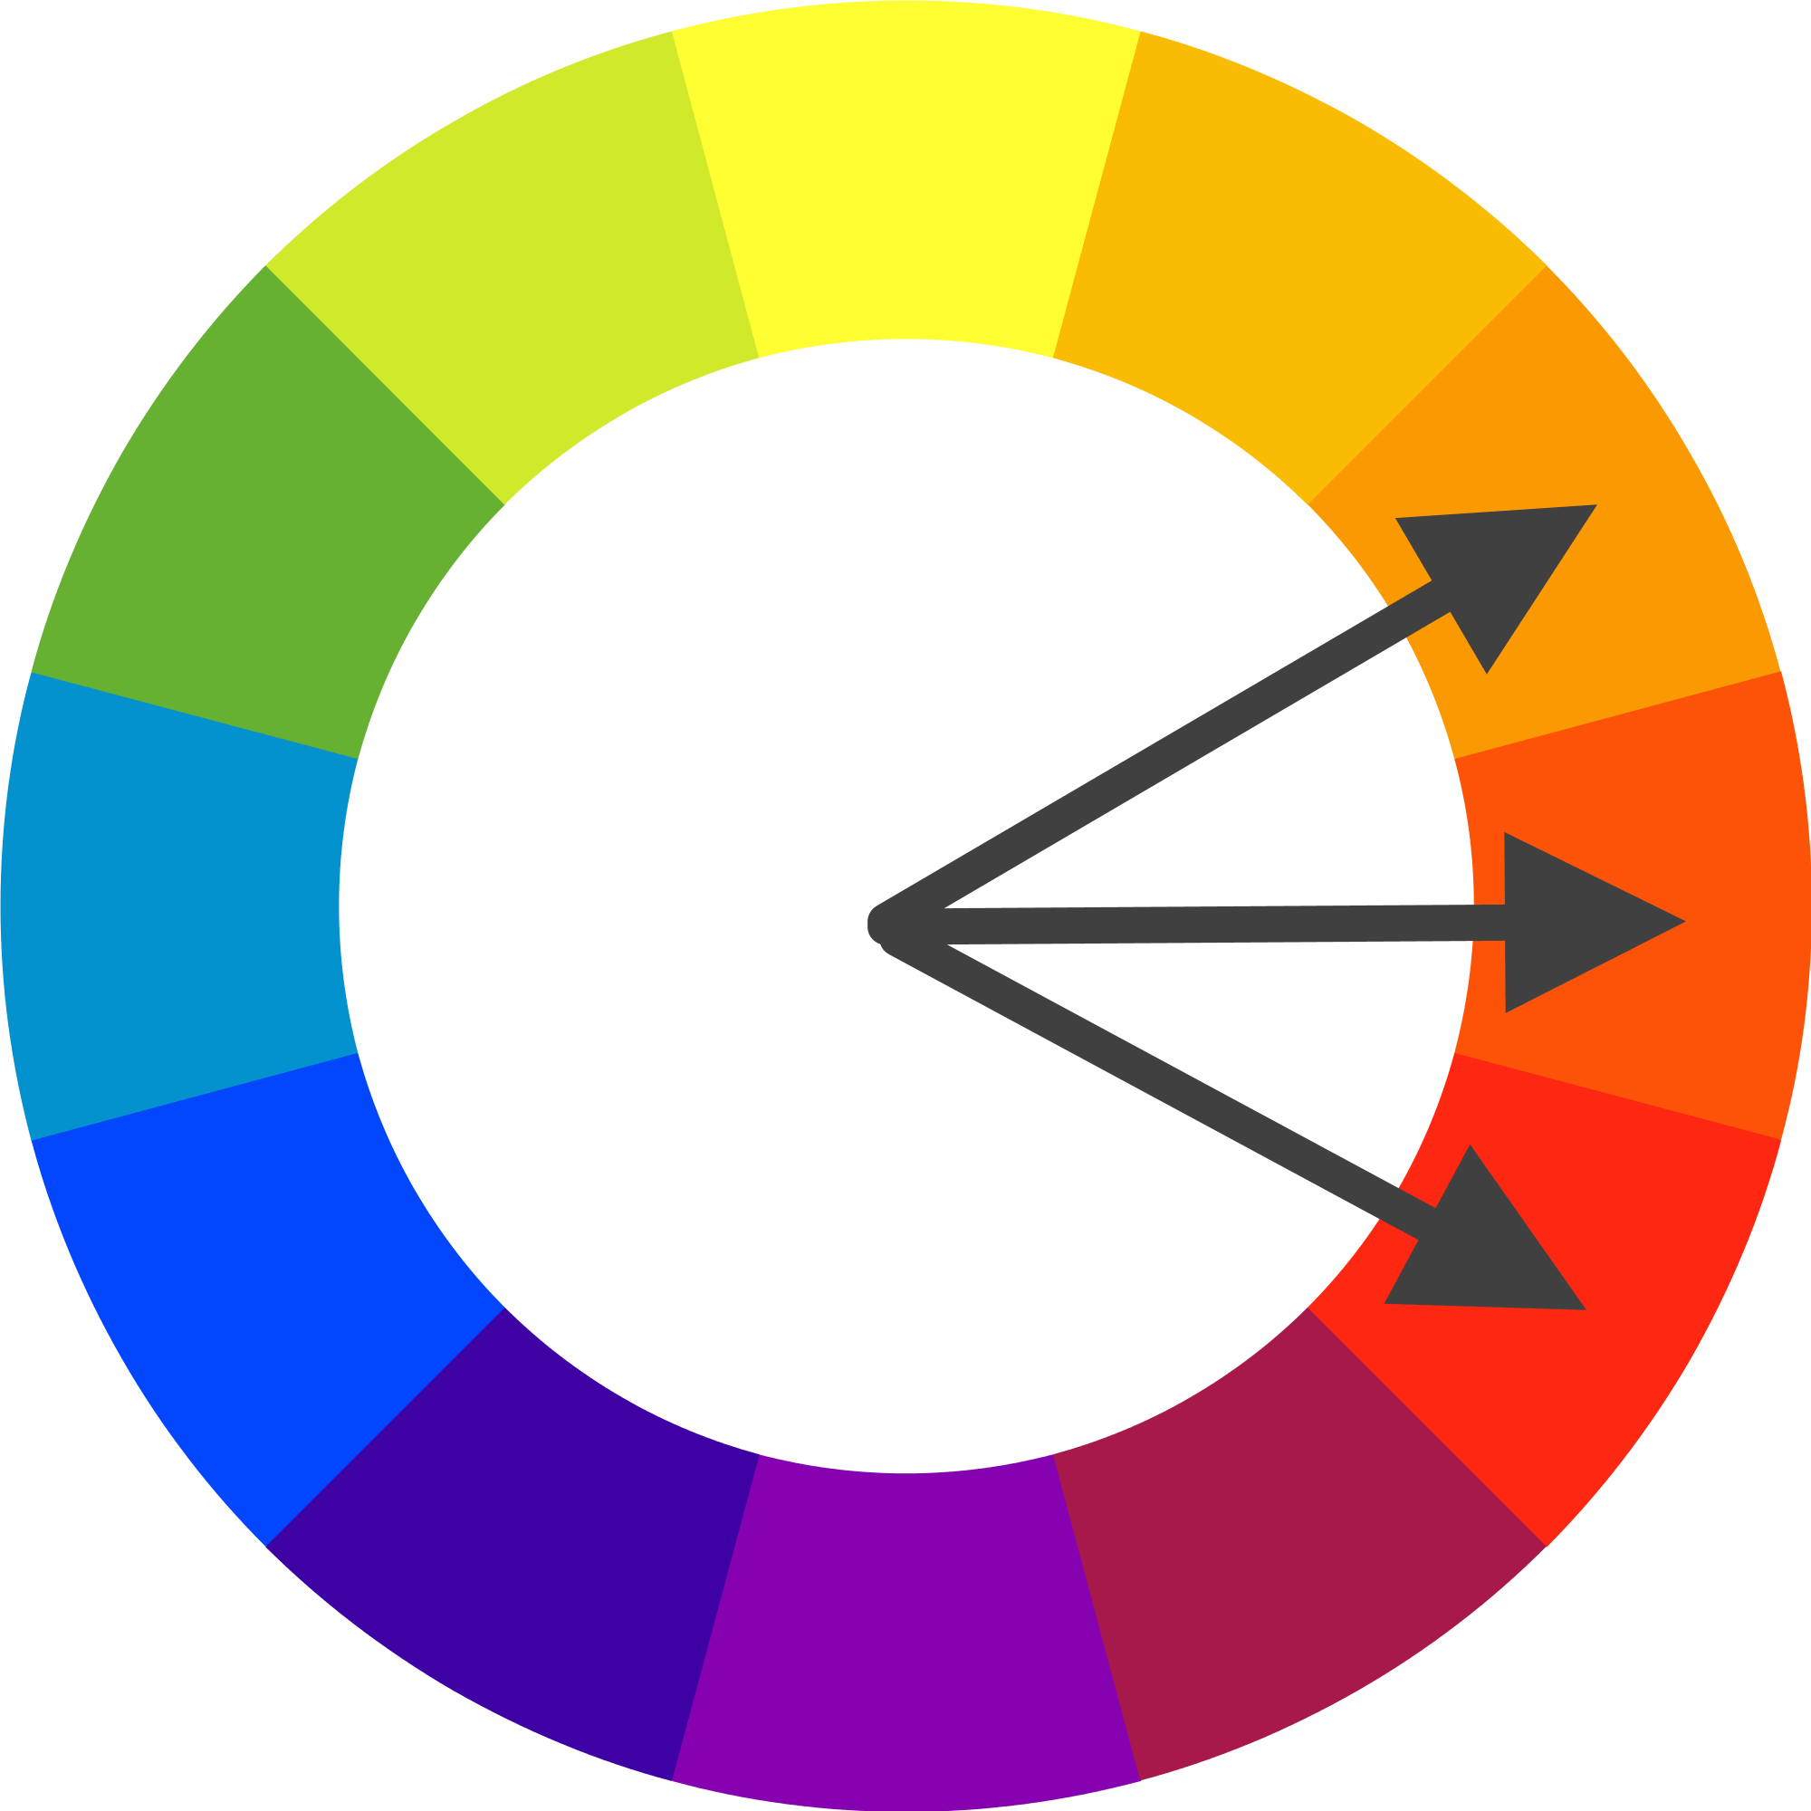
Warm (reds and oranges, with some yellow): Main scheme, colours of header bar which is on both pages
Cool (blues): Some comparatively smaller elements that are different on the two pages – the avatar image on Home and some of the photographs presented on Portfolio
Overall, the colours that I’ve decided on using for my website are a somewhat analogous scheme, which is also the same way in which I designed the original concept’s own palettes.
8 of 20

Slide 9


Although the content that’s the main focus of the Home page on my site is the text paragraphs containing the written introduction of myself and said website, I came to the decision while coding developments were underway that immediately above them will lie the video link that I planned to also include on this same page, this video being one containing various video shots that were filmed and edited together a few months ago, as a class exercise back in October. The inclusion of the video was done to fill more of the space on Home’s background by adding another element instead of the page just focusing on my introduction and avatar image, as well as setting more of the feel of what the website’s all about, and the gold-coloured tildes on either side of it are ones that I created in Photoshop, for decorational purposes to further fill more of the page background space.
The header bar, which is a design aspect primarily coded within a CSS file due to it being on both pages
The golden tilde symbols presented on either side of the video link, with both of these different types of elements being exclusive to the Home page unlike the header shown above
9 of 20

Slide 10
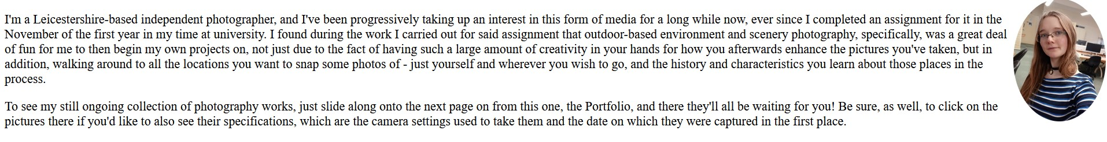
The previously-mentioned main paragraphs and accompanying avatar image on Home
I decided that I’d have these two complete paragraphs in a font which wasn’t that small, to avoid the emptiness around them which I found to have occurred on Tom Hull’s Info page, predominantly caused by his choice of having written its own paragraphs of text in quite a small size by comparison. Also, like what had been done for Adam Bird’s site’s About page, meanwhile, I thought that it was best to keep my writing in black over a white page background, to keep the text content easy to read and therefore maintain the professional look that I’m aiming to achieve through my site’s programmed design.
10 of 20

Slide 11
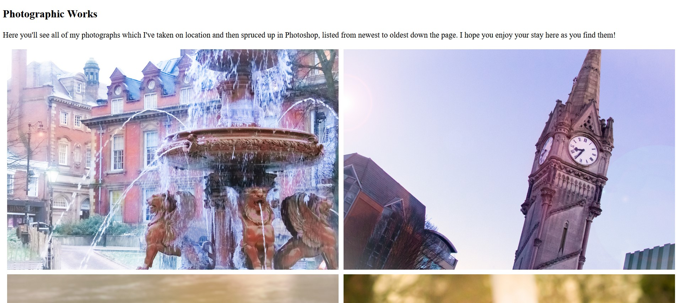
As shown below, for the other page, Portfolio, I adhered to my plan for an overall analogous colour scheme for my site; the latest two of the photographs presented on this page happen to both have cool tones of varying shades of blue and violet, so I made the decision to show the images down the page in the order of newest to oldest for two reasons: another way of making my design concept from a few weeks ago come true, and to serve as a contrast – though not too glaring or obvious – to the warm, mostly orange tones of the header bar displayed for the whole site. For a time, these photographs were originally packed together with their edges touching, until I decided to program in white borders to match the page background, to make their arrangements against each other neater and more streamlined.
The start of the main content area of the Portfolio page
11 of 20

Slide 12

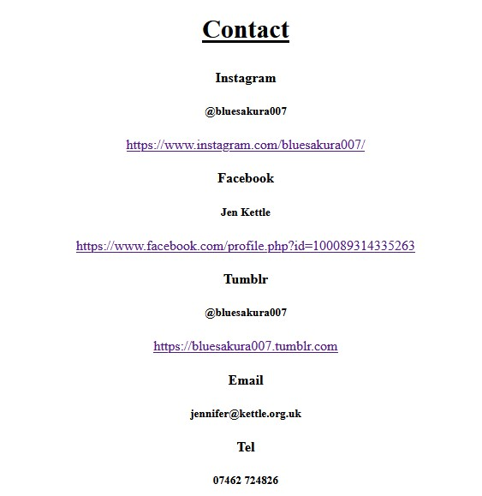
The tagline and navigation bar for my website as a whole – these are both more elements shown on both pages as a constant, like the header section
As shown below, for the other page, Portfolio, I adhered to my plan for an overall analogous colour scheme for my site; the latest two of the photographs presented on this page happen to both have cool tones of varying shades of blue and violet, so I made the decision to show the images down the page in the order of newest to oldest for two reasons: another way of making my design concept from a few weeks ago come true, and to serve as a contrast – though not too glaring or obvious – to the warm, mostly orange tones of the header bar displayed for the whole site. For a time, these photographs were originally packed together with their edges touching, until I decided to program in white borders to match the page background, to make their arrangements against each other neater and more streamlined.
Another section of content programmed and designed for both pages: the Contact area
12 of 20

Slide 13
13 of 20

Slide 14
14 of 20

Slide 15
15 of 20

Slide 16
16 of 20

Slide 17
17 of 20

Slide 18
18 of 20

Slide 19
19 of 20

Slide 20
20 of 20

